Slide 1
AI ENABLED INVOICE MANAGEMENT SYSTEM
Submitted in the partial fulfillment for the award of the degree of
BACHELOR OF ENGINEERING
IN
COMPUTER SCIENCE AND ENGINEERING
Submitted by :
SUMEER SHARMA (19BCS6018)
Under the Supervision of:
Prof. Deepak Kumar
Department of AIT-CSE
DISCOVER . LEARN . EMPOWER

Slide 2
Outline :-
Introduction to Project
Problem Formulation
Objectives of the work
Methodology used
Results and Outputs
Conclusion
Future Scope
References

Slide 3
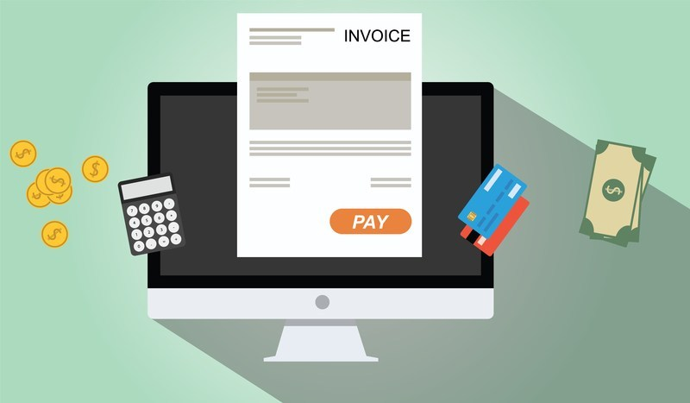
Introduction to Project :-
Problem definition :
The B2B (Business to Business) world actually operates bit differently from the B2C (Business to Customer) or C2C (Customer to Customer) world. Businesses work with other businesses on credit. When a buyer business orders good from the seller business, the seller business issues an invoice for the same. Now, this invoice basically contains various information for the goods supplied such as payment due date, invoice date, invoice amount, baseline data etc. In accounting terminology, it is known as, “Accounts Receivable”
Credit: https://project-management.com/wp-content/uploads/2019/03/online-invoicing.jpg

Slide 4
Problem Formulation :-
A business is defined as an organization or enterprising entity engaged in commercial, industrial, or professional activities. Business can basically be divided into on the basis of Monetary, i.e., Profitable or Non-profitable Organizations. But most business operates on the motive of generating profit. Business can be of different types. Some of them are -:
Sole proprietorships
Corporations
Partnerships .
Limited liability companies
In order to start a business, you need a proper plan. Briefly speaking, this plan should include Market Research, Consumer Research and all the necessities. In Order to run a business well, the company should keep all the financial records up to date and well managed. Financial Management is the key factor of the business. Managing the Finance, like where to invest, how to invest and when to invest are the key points. Managing how much consumers are going to pay us and how much we need to pay the consumer indeed makes a good impact on everyone.

Slide 5
Project overview/specifications :
The main aim, therefore, of the project is to build a machine learning model to predict the payment date of an invoice when it gets created in the system. Along with that, to build a full stack Invoice Management Application. Considering the features too there’s a Receivables Dashboard to visualize data in the form of grids, functionalities such as ADD, EDIT and DELETE, easy navigation through pagination. Building of a full stack Invoice Management Application using React-JS, JDBC, Java, Servlets. Performing searching operations on the invoices. Certain important features consist of UI Creation, Grid Creation, Grid data loading, Crud operation (add, edit and delete), pagination, advanced search etc.
Hardware specifications :
The hardware specification that our project demands for are: A virtual machine (Windows or Mac OS) installed with given list of software.

Slide 6
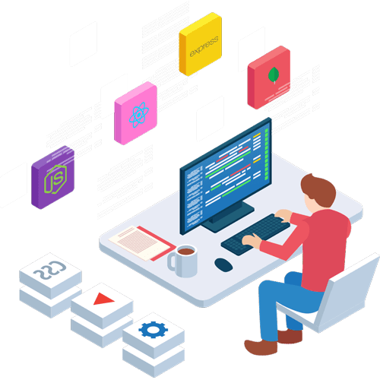
Software specifications :
MACHINE LEARNING REQUIREMENTS:
➢ NumPy
➢ Pandas
➢ Matplotlib
➢ Scikit-learn
FRONT-END REQUIREMENTS :
➢ HTML
➢ CSS
➢ JavaScript
➢ jQuery
BACK-END REQUIREMENTS :
➢ Java
➢ Servlets
➢ JDBC
➢ JSP
➢ MySQL

Slide 7
So basically, in existing system all the data entry, calculations work is done manually which is very hectic for any person therefore to overcome this problem in proposed system we have computerized all the operations aim of our proposed system is to develop a system of improved facilities.
The proposed system can overcome all the limitations of existing system.
The system provides proper security and reduces the manual work. Following are the benefits of proposed model –
• Security of data.
• Ensure data Accuracy’s.
• Minimize manual data entry
• Greater efficiency
• Better Service
• Minimum Time Required

Slide 8
Objectives :-
The main objective/aim of our project is to develop a system of improved facilities. With that we mean that our proposed system can overcome all the limitations of existing system, that is to build a machine learning model to predict the payment date of an invoice when it gets created in the system. Along with that, to build a full stack Invoice Management Application.
Accounts Receivable represents money owed by entities to the firm on the sale of products of services on credit. In most business entities, accounts receivable is typically executed by generating an invoice and either mailing or electronically delivering it to the customer, who, in turn, must pay it within established timeframe, called credit terms or payment terms. ”Now, seller business interacts with various businesses and sells various goods to them and that too at various times.
Certain important features in the project includes UI Creation, Grid Creation, Grid data loading, Crud operation (add, edit and delete), pagination, advanced search etc.

Slide 9

Methodology used :-
Methodology for this project are as follows:
Data Cleaning and Preprocessing:
Following are the steps that we will follow to prepare the dataset training of ML model –
• format of the dates are of different timestamps.
• The data also includes the NULL values we will replace the mean values with median.
• We will convert the categorical data like (USD, Rupee) to the numerical format like 0,1 etc.
• As the date includes the information like month, year and day so we will separate the values accordingly.
• We will calculate the difference between the columns Clear_ date, due_term values that will be output of our Model.
Image Credit: https://miro.medium.com/max/838/1*cilm6DLWyv4nohGzkl44rA.png

Slide 10
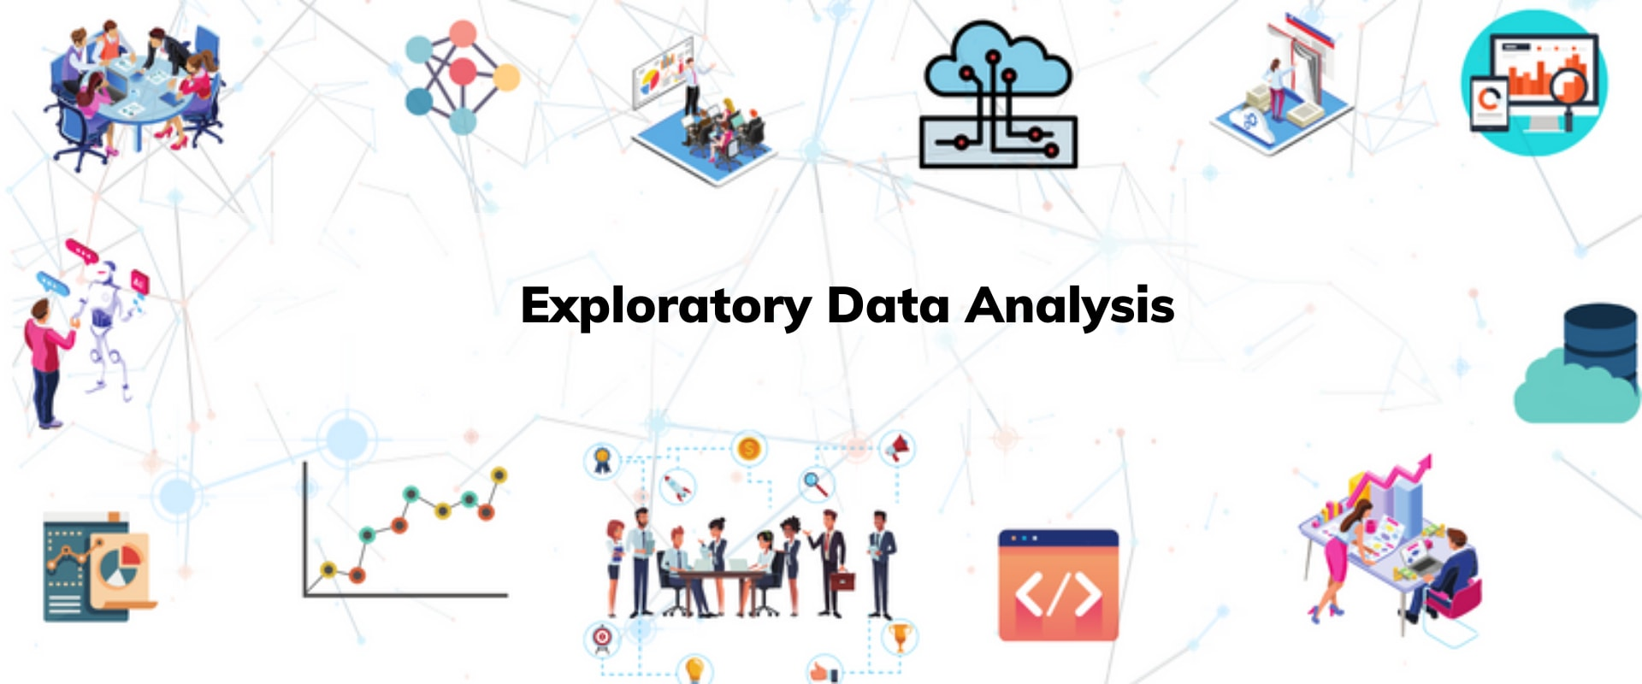
Exploratory Data Analysis:
Following are the steps that we will follow – •The date includes some unnecessary information like S. No. which does not give any information about data. • We will remove those columns which do not plays that much role for the prediction using the correlation Matrix. • We will remove the outliers from the data and normalize it so that the data will be balanced
Model Preparation:
After cleaning and balancing the data we will split that data in ration 8:2 for the training and test. For the prediction we will use Machine learning algorithms like SVM, Random Forest etc. As the Model will be trained, we’ll save the model file to connect it with the backend of the system.

Slide 11
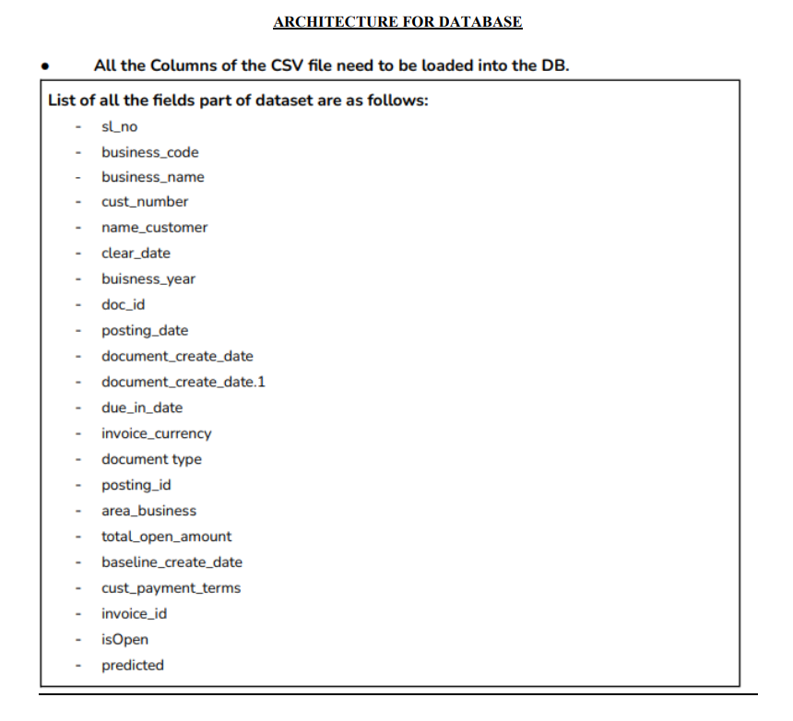
Backend and Database:
Following are the functionalities that we’ll be providing in the Backend of the system. For the prediction of Model, we need the data so we will be creating the database whose architecture is as following:

Slide 12
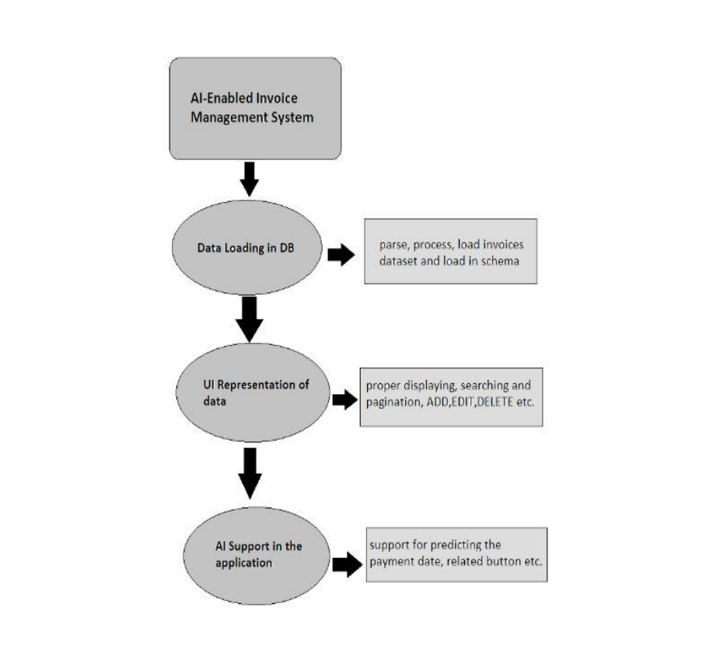
Pictorial Representation of Project :-

Slide 13
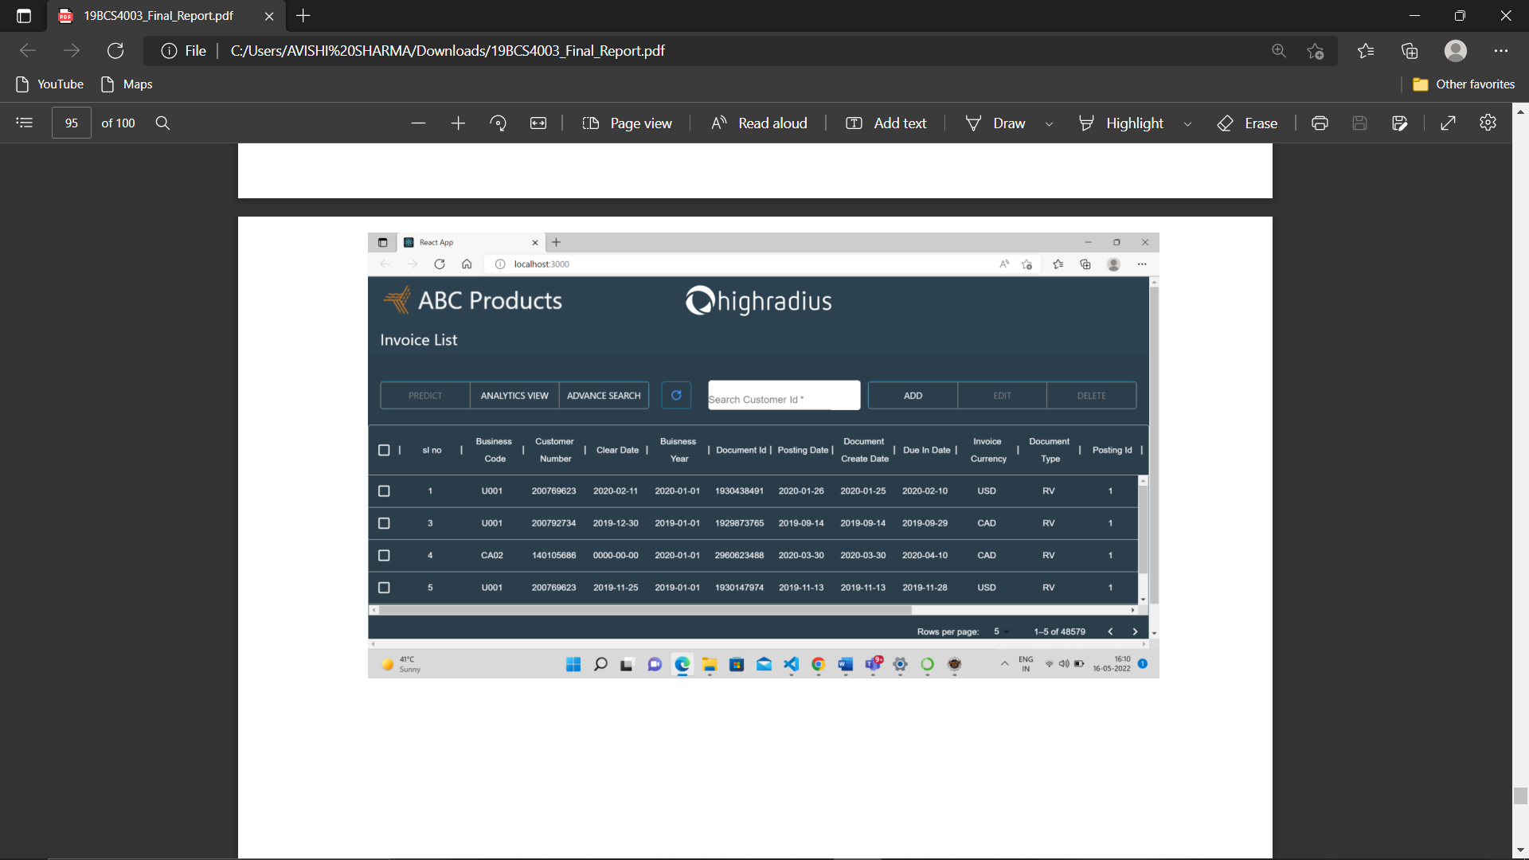
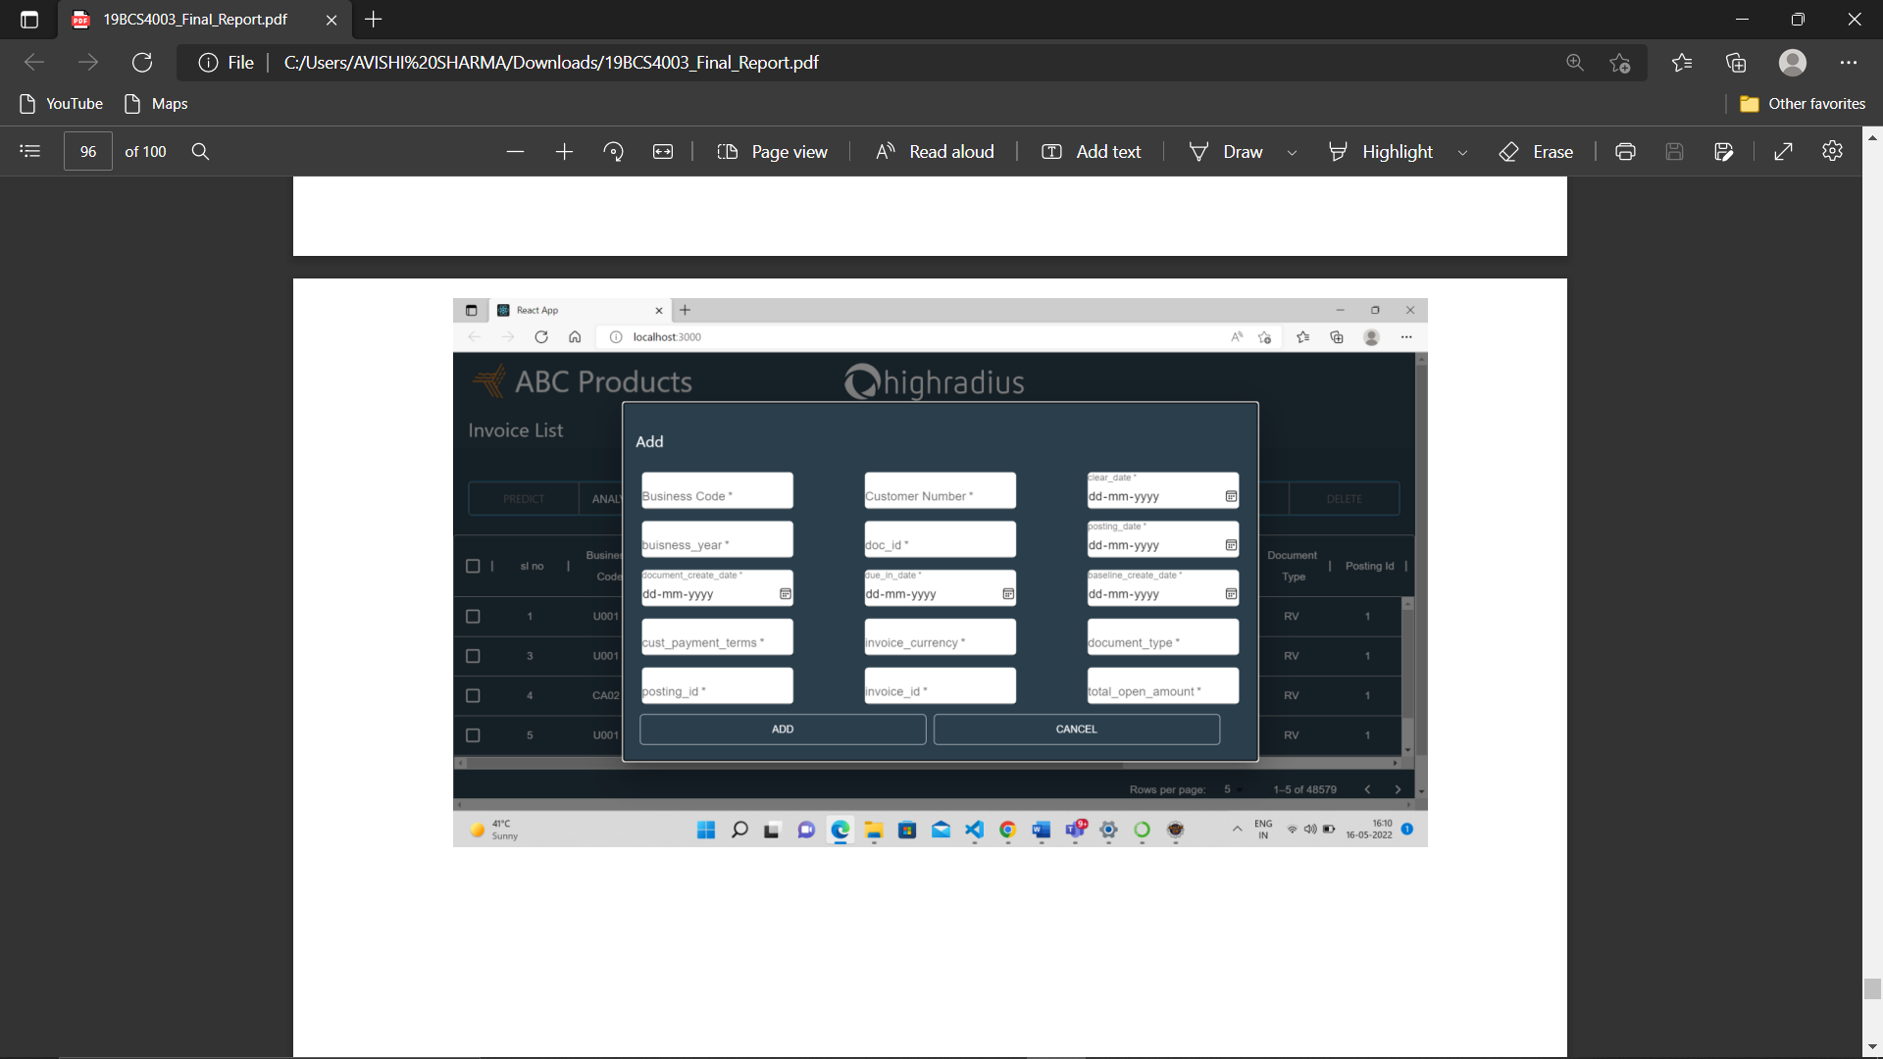
Results and Outputs :-
Front-End of the Project:

Slide 14
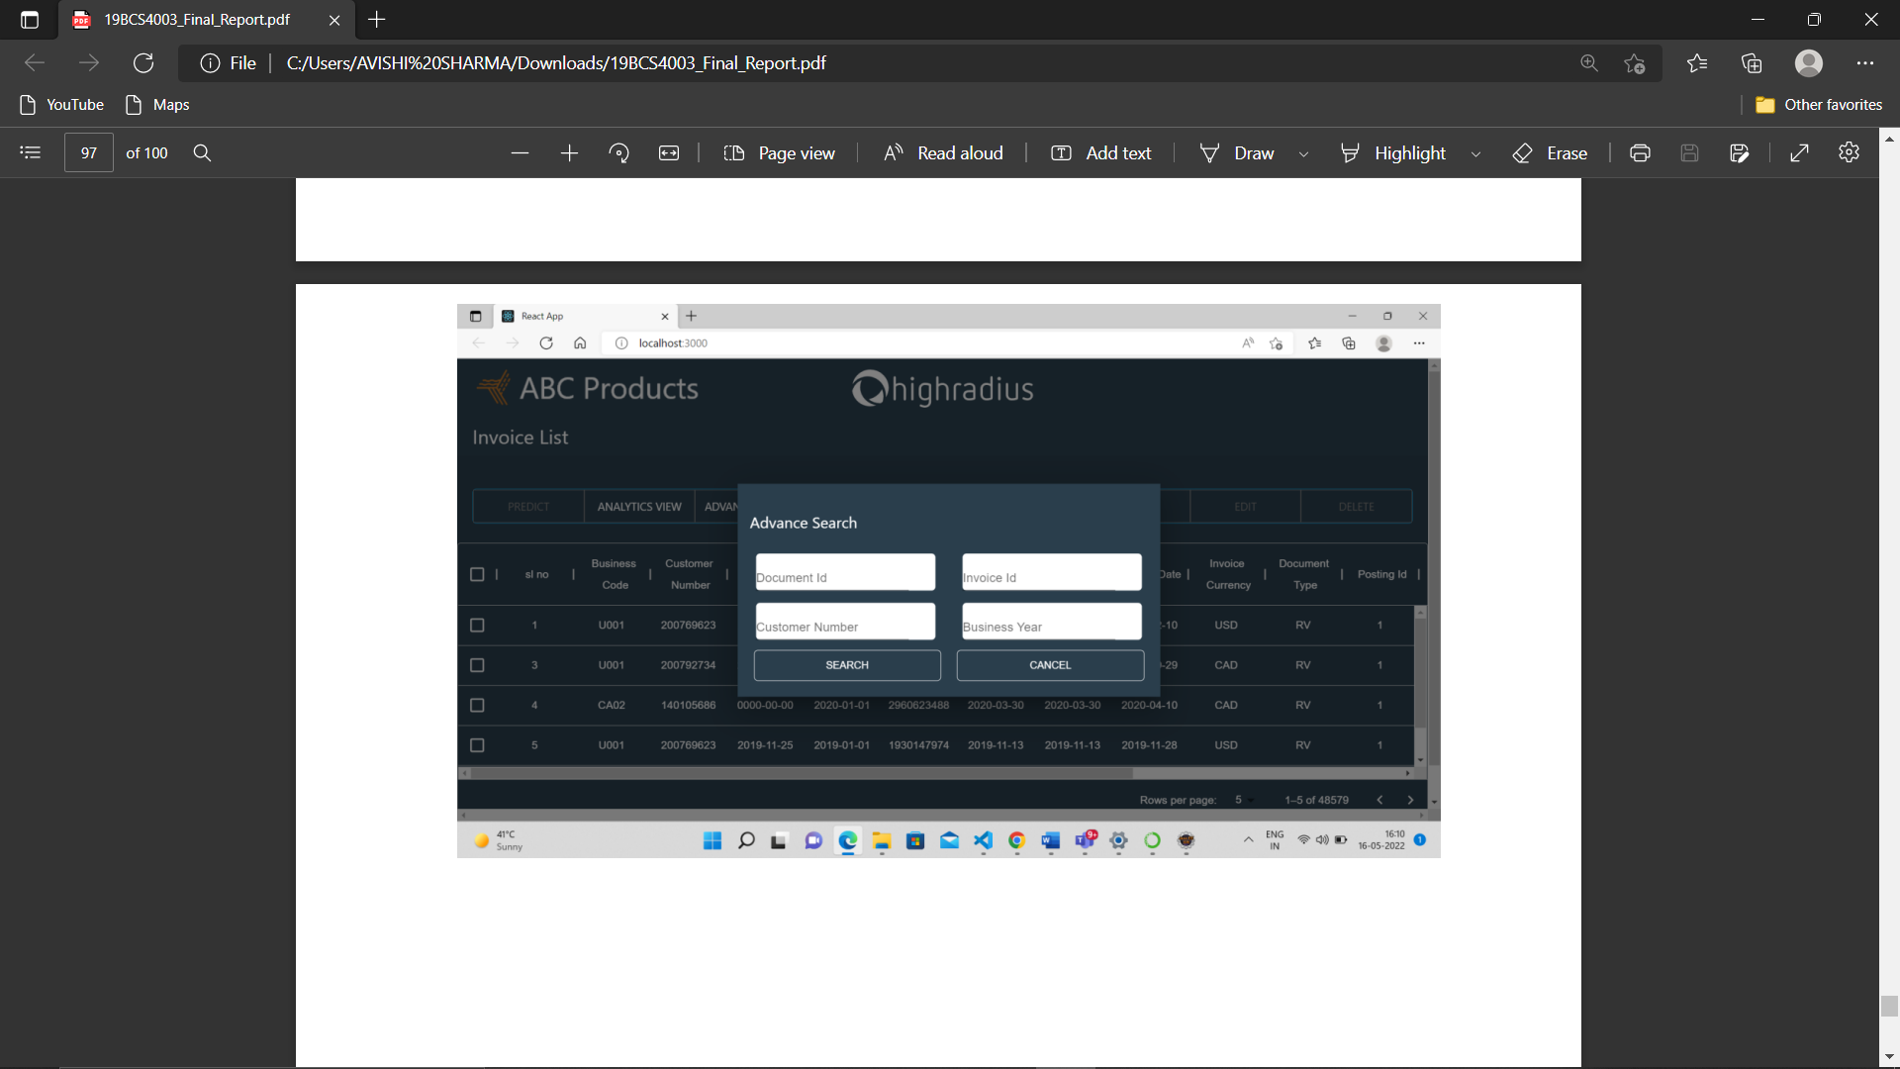
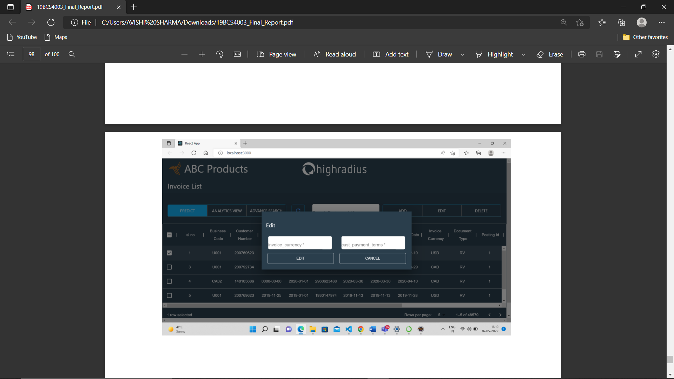

Slide 15
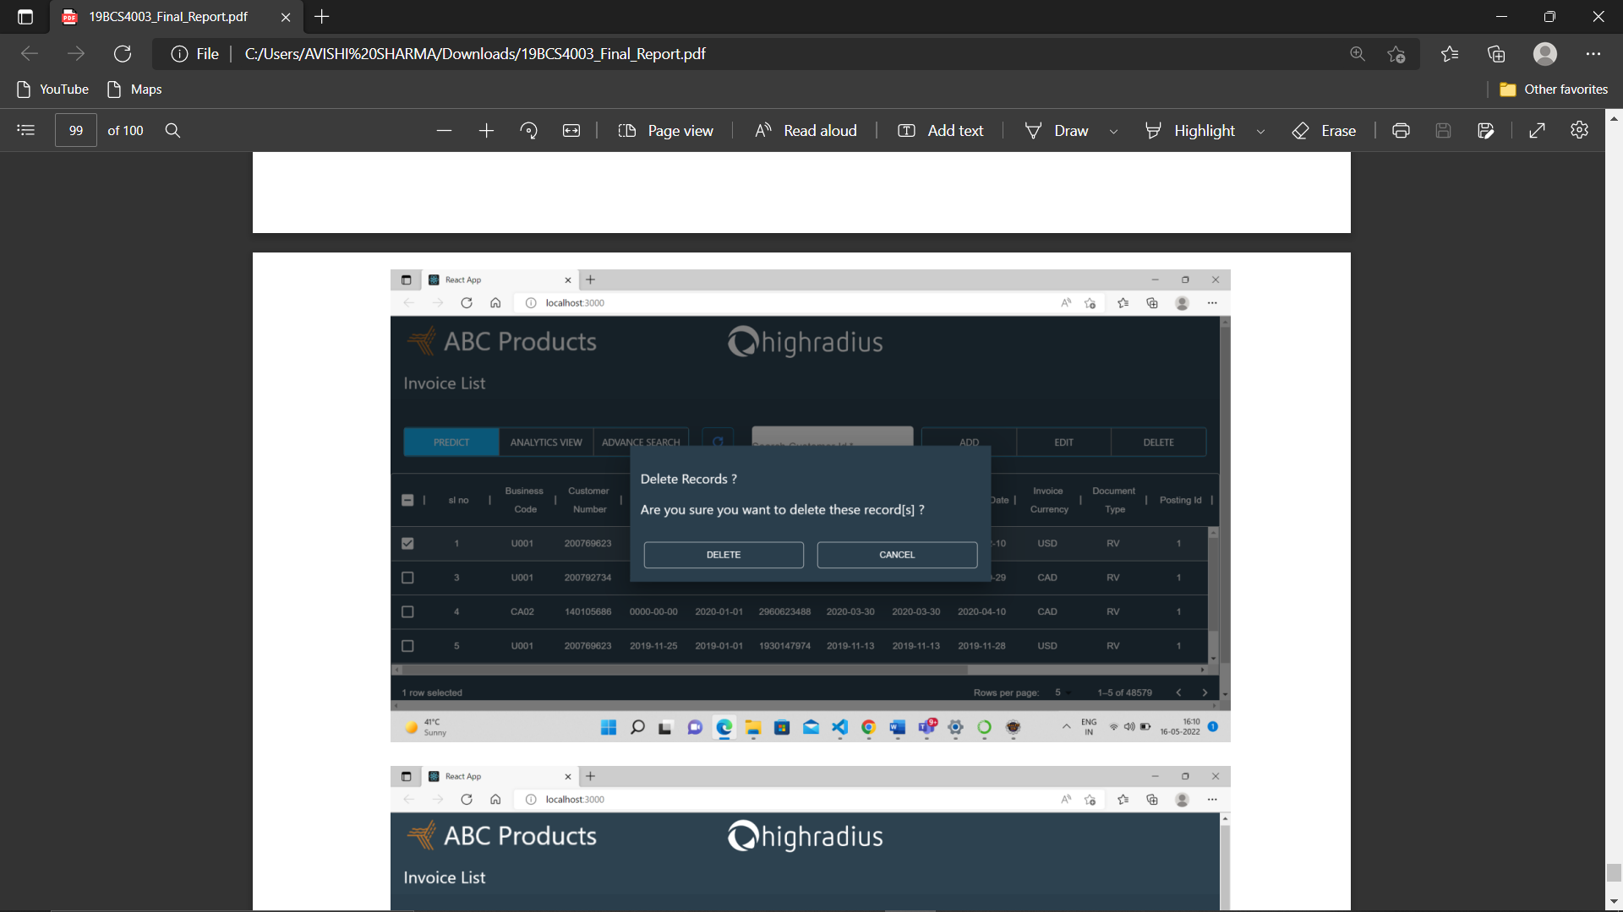
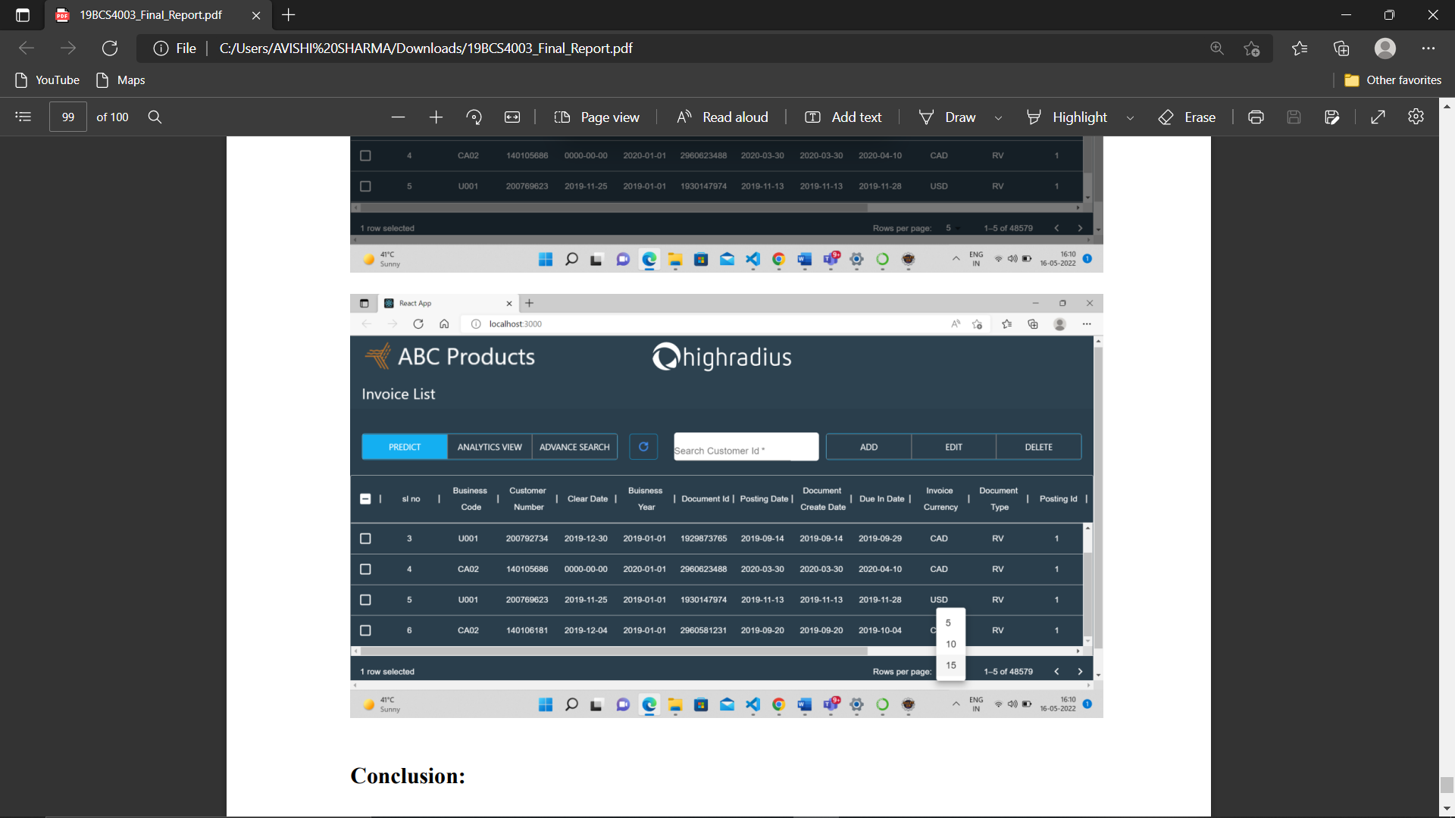

Slide 16
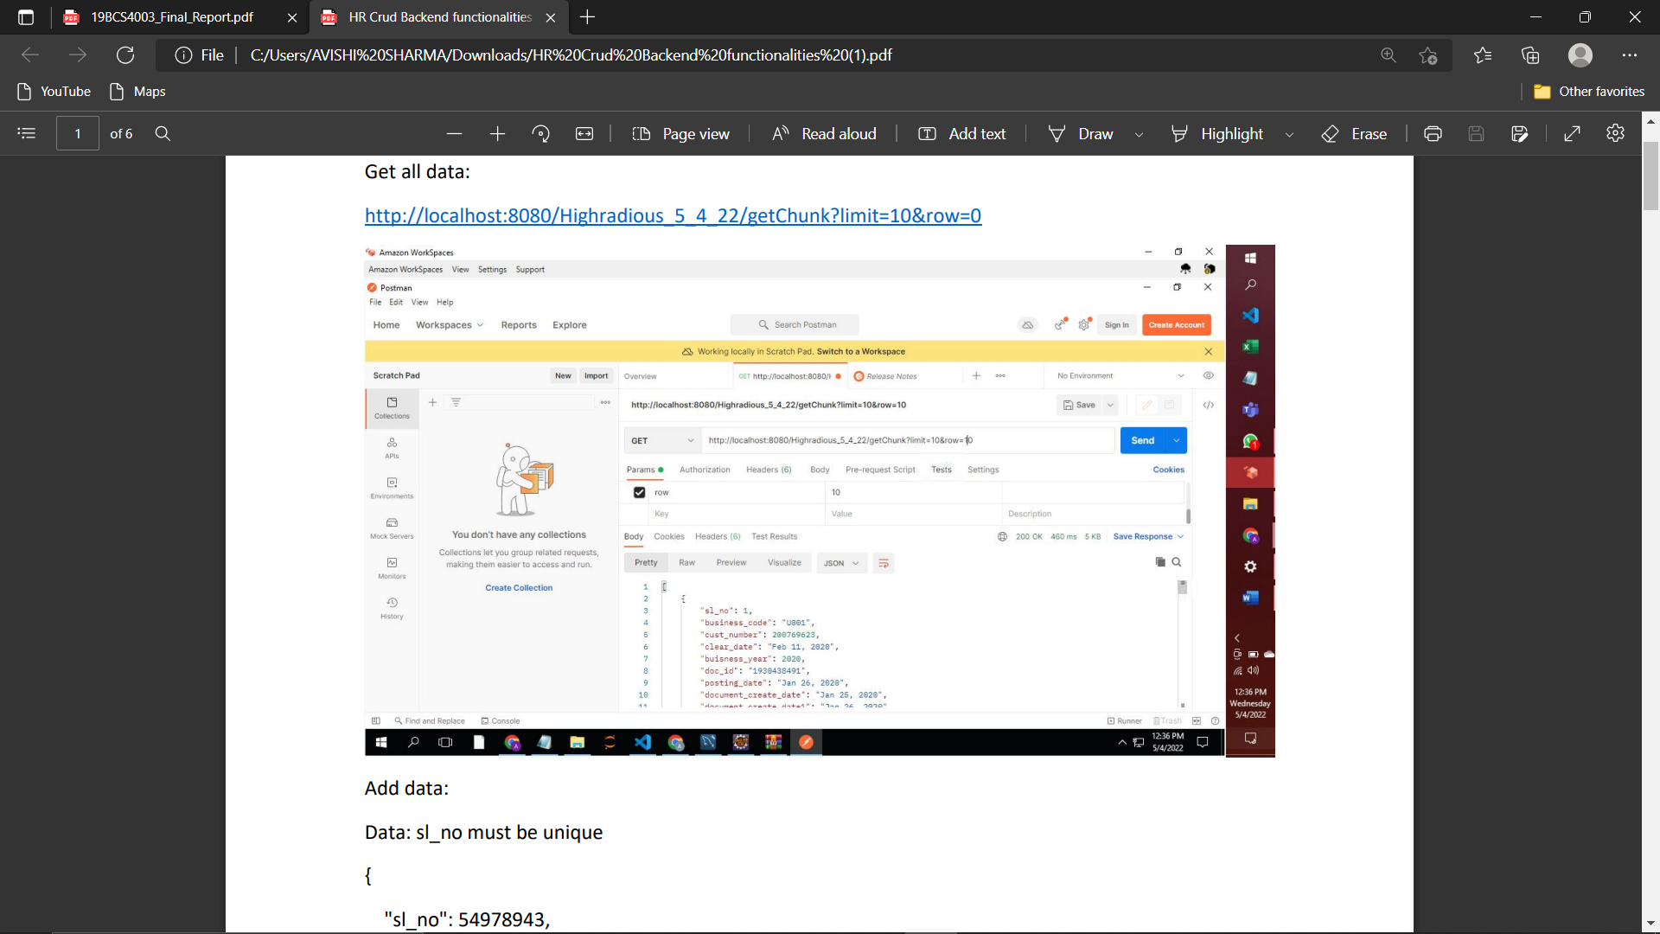
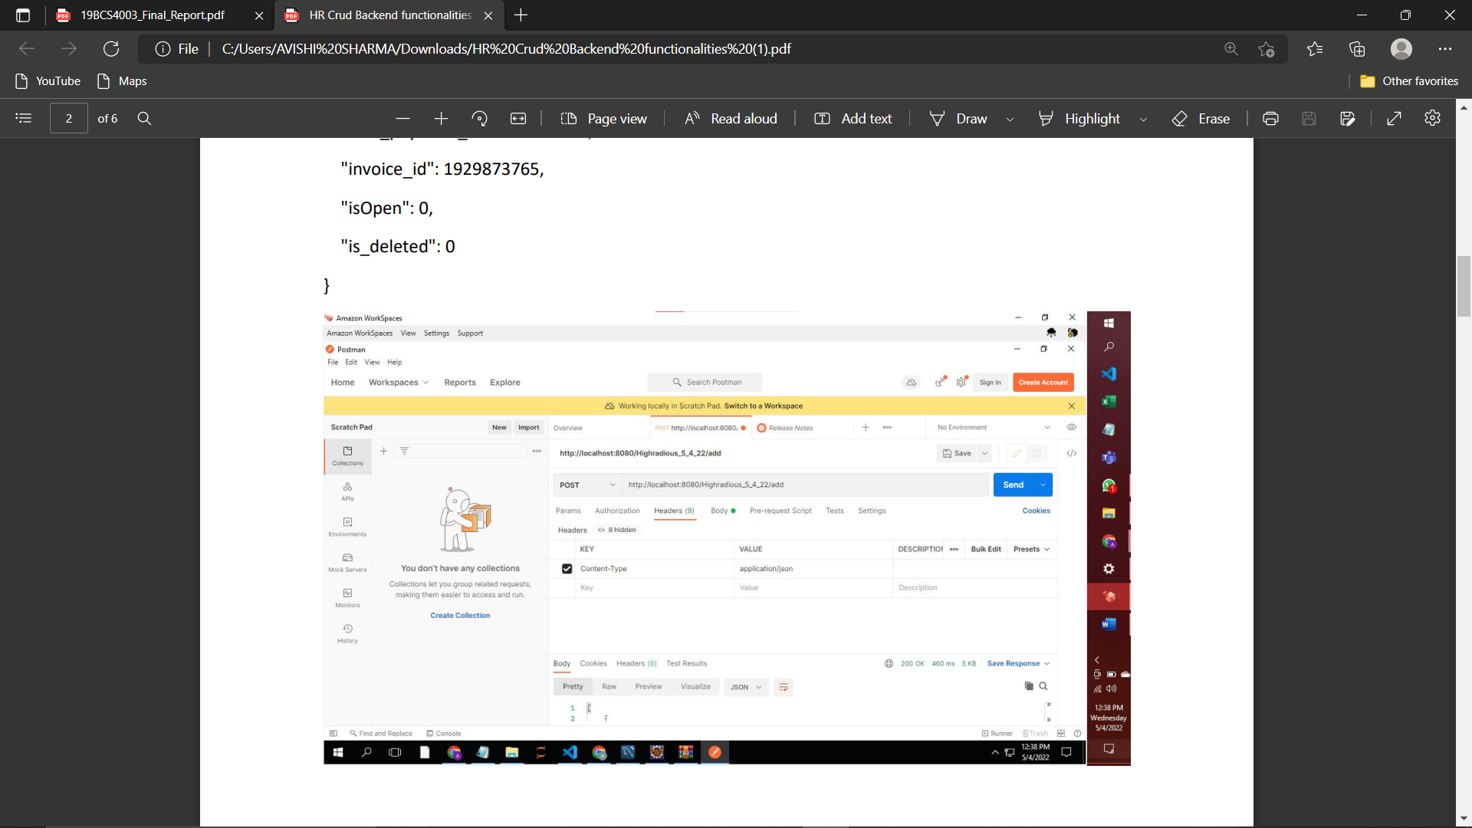
Back-End of the Project:

Slide 17
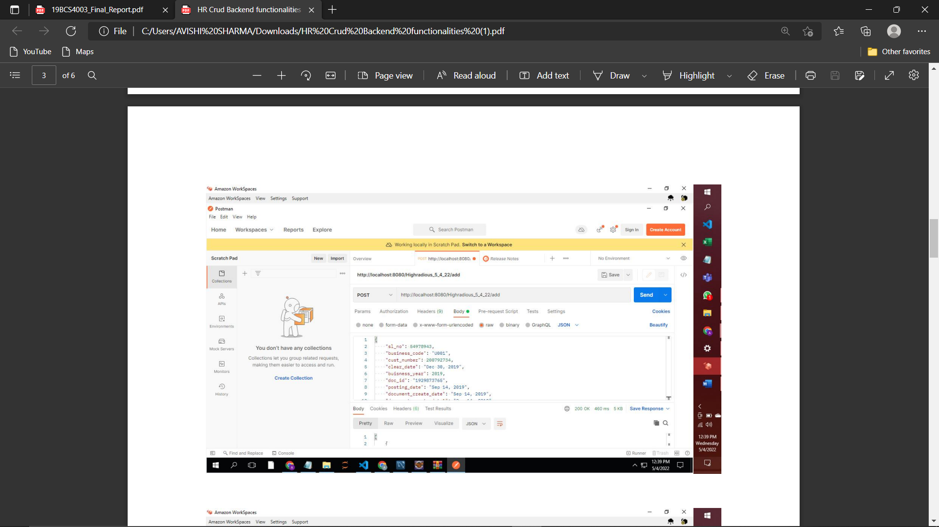
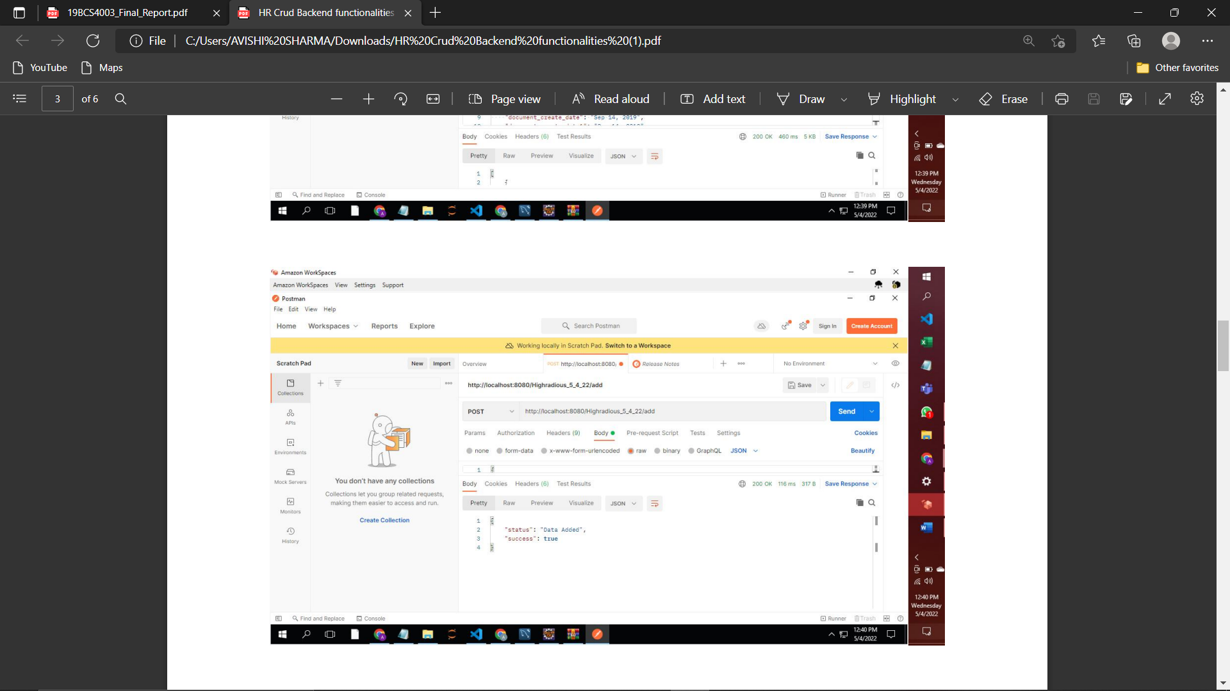

Slide 18
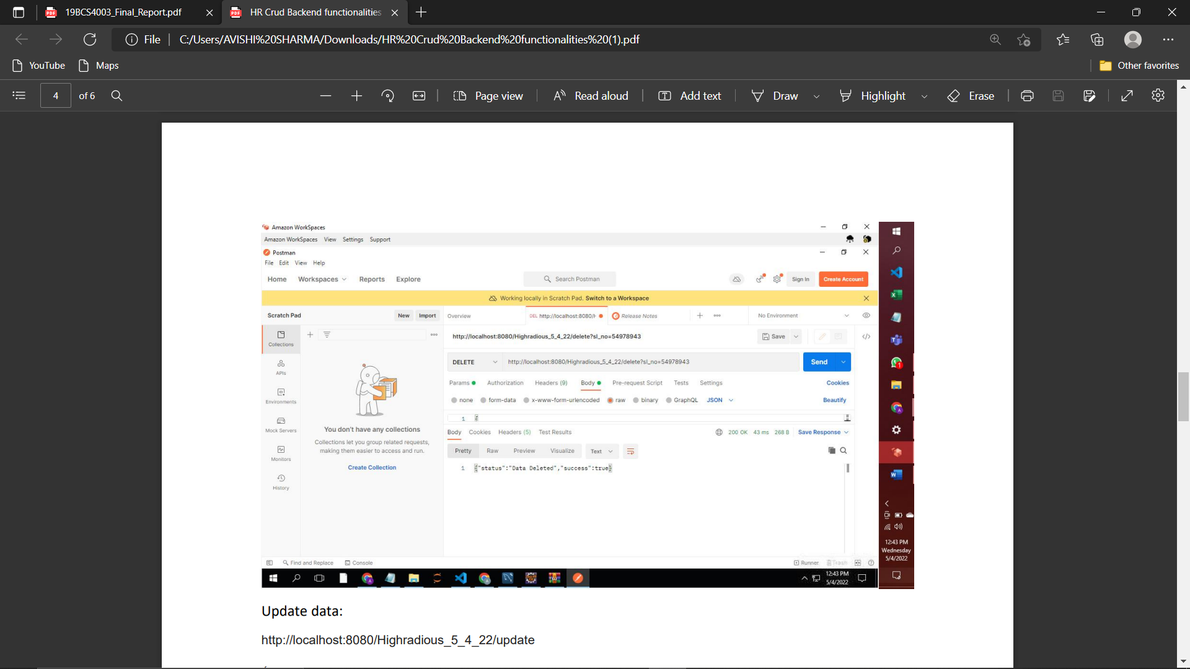
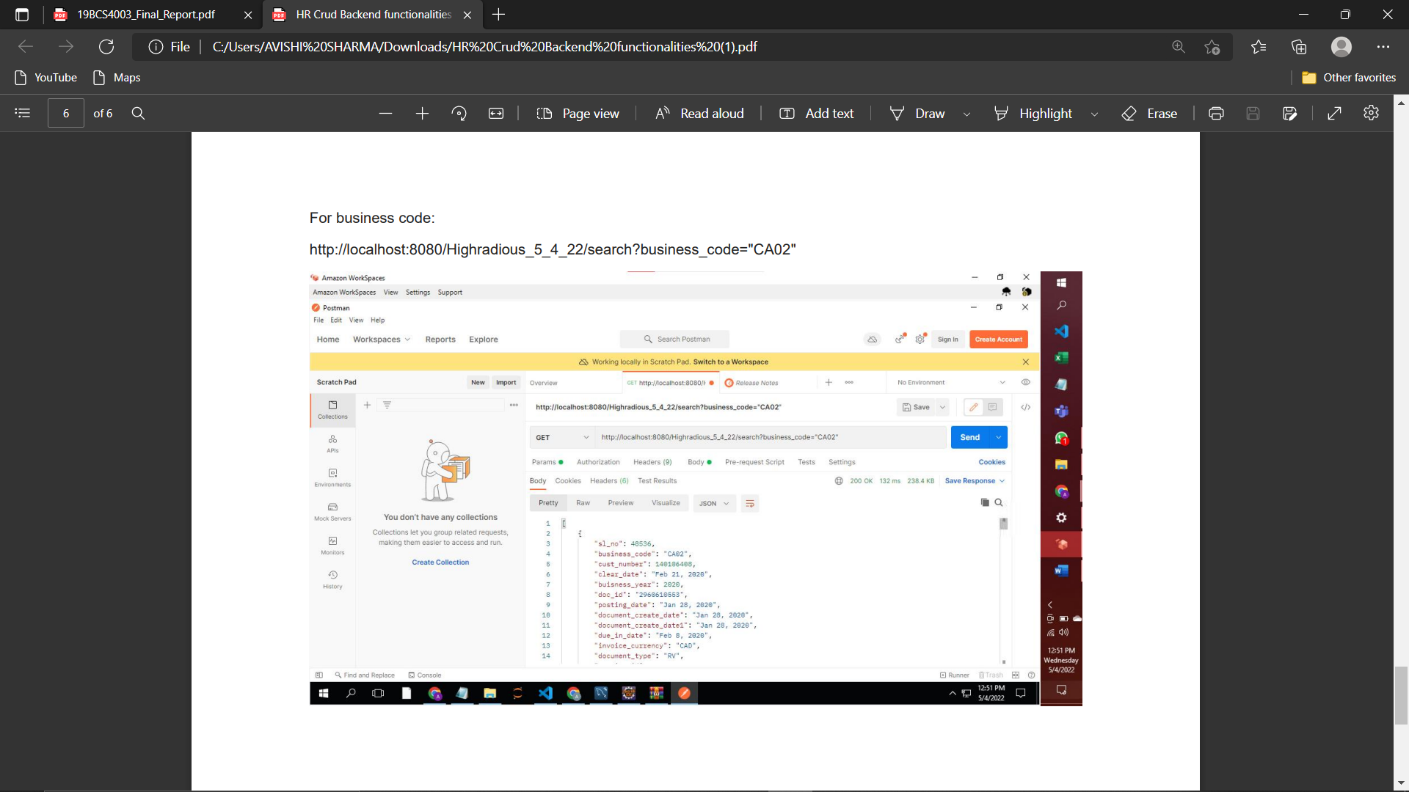

Slide 19

Conclusion :-
Our Project is only a humble venture to satisfy the needs to manage their project work. Several user friendly coding have also adopted. This package shall prove to be a powerful package in satisfying all the requirements of the school. The objective of software planning is to provide a frame work that enables the manager to make reasonable estimates made within a limited time frame at the beginning of the software project and should be updated regularly as the project progresses. At the end we have concluded that we have made effort on following points –
• A description of the background and context of project and its relation to work already done in the area.
• Made statement of the aims and objectives of the project.
• The description of Purpose, Scope and applicability.
• We define the problem on which we are working in the project.
• We describe the requirement Specifications of the system and the actions that can be done on these things.
• We understand the problem domain and produce a model of the system, which describes operations that can be performed on the system.
• We included features and operations in detail, including screen layouts.
• We designed user interface and security issues related to system.
• Finally the system is implemented and tested according to the test cases.

Slide 20
Future Scope :-
In a nutshell, it can be summarized that the future scope of the project circles around maintaining information regarding –
• We can add printer in future.
• We can give more advance software for Invoice Management System including more facilities.
• We will host the platform on online servers to make it accessible worldwide.
• Integrate multiple load balancers to distribute the loads of the system.
• Create the master and slave database structures to reduce the overload of the database queries.
• Implement the backup mechanism for taking backup of the codebase and database on the regular basis on the different servers
The above mentioned points are the enhancements which can be done to increase the applicability and usage of this project. Here we can maintain the records of Invoice and Clients.

Slide 21
References :-
https://www.netsuite.com/portal/resource/articles/financialmanagement/financialmanagement.shtml
https://www.economicsdiscussion.net/business/what-is-business/32494
https://www.investopedia.com/terms/b/business.asp
https://www.tutorialspoint.com/sql-tutorial-learn-sql-with-mysql-database-beginner-toexpert/index.asp
https://reactjs.org/docs/getting-started.html

